Slide 1
Word Embeddings

Slide 2
Natural Language Processing
How do we represent words in computer?

Slide 3
Easy way: one-hot encoding
One-hot vectors of dictionary size (ex. 500,000)
1
0
0
…
0
cat =
mother =
n (=500000) coordinates
0
…
1
...
0
i-th coordinate

Slide 4
One-hot encoding
One-hot vectors of dictionary size (ex. 500,000)
Problems:
vectors do not contain meaning
no similarity measure between vectors

Slide 5
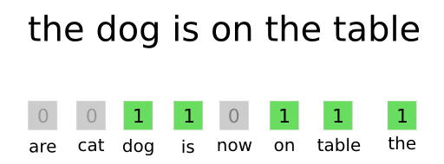
Bag-of-Words
Summa one-hot vectors of words

Slide 6
Bag-of-Words
Summa one-hot vectors of words
Problem:
no word order information

Slide 7
More clever way: context embeddings
Let’s consider words that can fit in the gaps:
Marie rode a ______
______ wheel was punctured
The ______ has a beautiful white frame
 | 1 | 2 | 3
Bicycle | + | + | +
Bike | + | + | +
Car | + | + | -
Horse | + | - | -

Slide 8
Context embeddings
Let’s take into account words meanings in some way:
v(word_{i})[ j ] = count(co-occurrences word_{i} with word_{j} in dataset)
v(word₁) = [12, 1, 0, 10, 5,...]
horse ride wheel roof hair breed
v(word₂) = [20, 10, 0, 0, 1,...]
car ride wheel roof hair breed

Slide 9
Context embeddings
v(word_{i})[ j ] = count(co-occurrences word_{i} with word_{j} in dataset)
[5, 5, 4, 3,…]
[12, 1, 2, 0, 5,…]
Dimensional reduction
v(word) =

Slide 10
Context embeddings
Problems:
rare words
huge computational time
when you change your dataset you need to recompute everything

Slide 11
Latent semantic analysis
document
SVD
≈
✕
✕
word
We can compute similarity with cosine metric.

Slide 12
Latent semantic analysis
document vector
word vector
document
d
SVD
≈
✕
✕
w
word
We can compute similarity between vectors with cosine metric.

Slide 13
Latent semantic analysis
We get small-dimensional vectors
Vectors contain meanings of words
We can compute distance between words (cosine distance)

Slide 14
Latent semantic analysis
We get small-dimensional vectors
Vectors contain meanings of words
We can compute distance between words (cosine distance)
Problems:
huge computational time
when you change your dataset you need to recompute everything

Slide 15
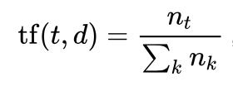



Tf-idf
document d
count term frequency in the document
term t

Slide 16
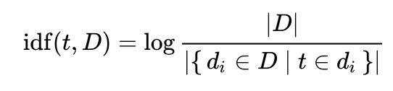
Tf-idf
document d
count term frequency in the document
take into account very usual words:
inverse document frequency
term t

Slide 17

Tf-idf
document d
count term frequency in the document
take into account very usual words:
inverse document frequency
term t

Slide 18
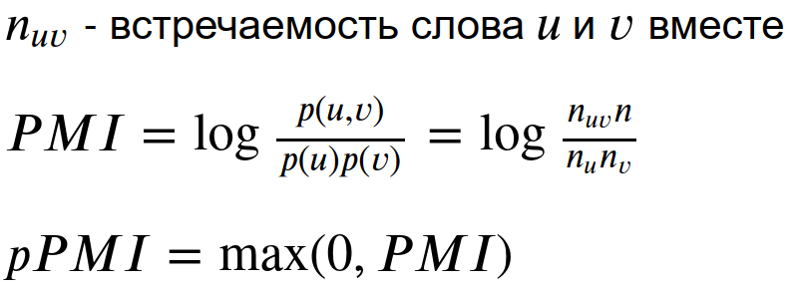
Pointwise mutual information
Fixed length sliding window:

Slide 19
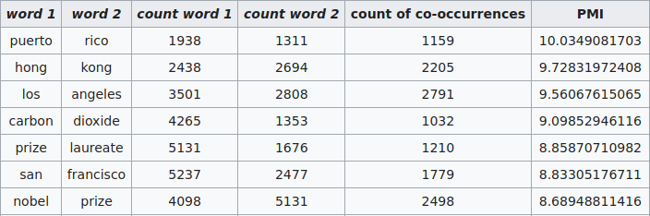
Pointwise mutual information

Slide 20

Pointwise mutual information
word vector
word vector
v word
v
SVD
≈
✕
✕
u
u word

Slide 21
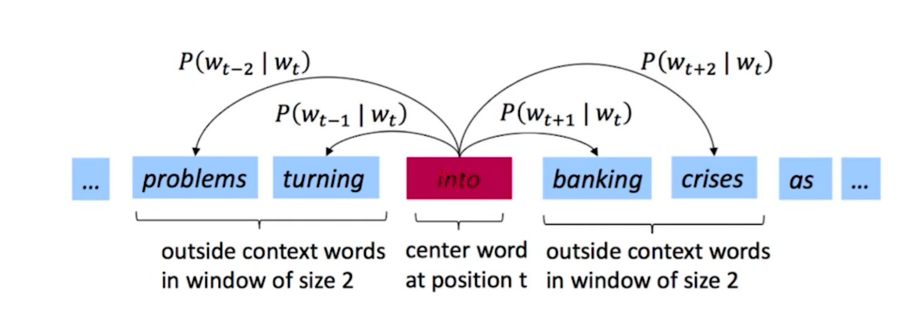
Word2Vec
We want to maximize probabilities of seeing a surrounding word based on center words.
Going through text corpus by sliding windows.

Slide 22
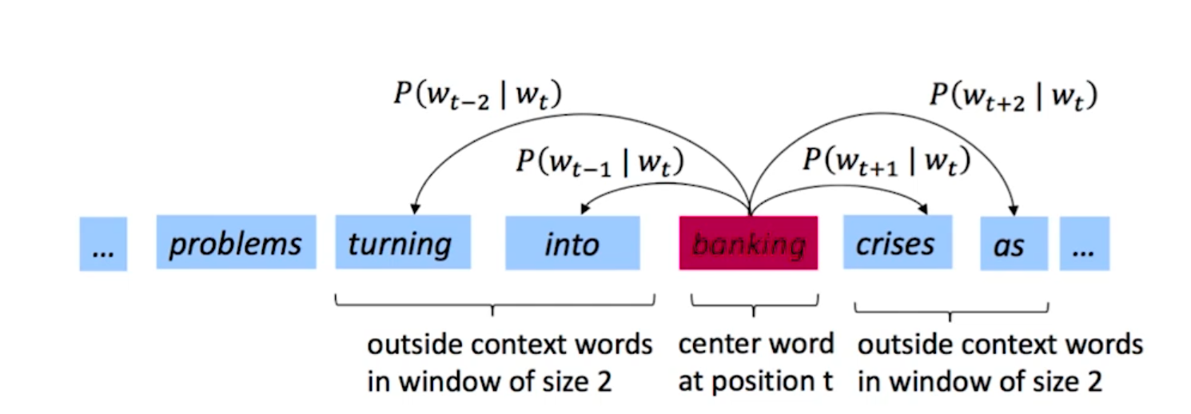
Word2Vec
We want to maximize probabilities of seeing a surrounding word based on center words.
Going through text corpus by sliding windows.

Slide 23
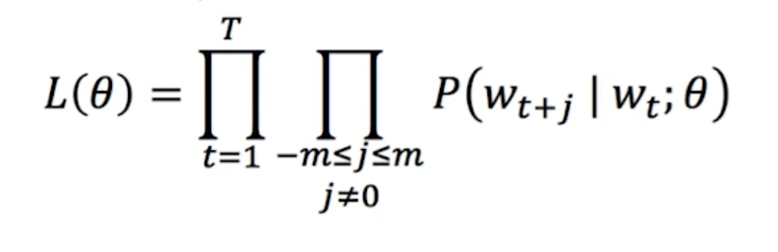
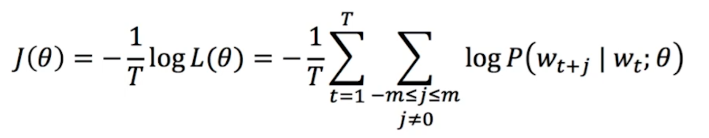
Word2Vec
Target function:
Or in log-likelihood point of view:

Slide 24
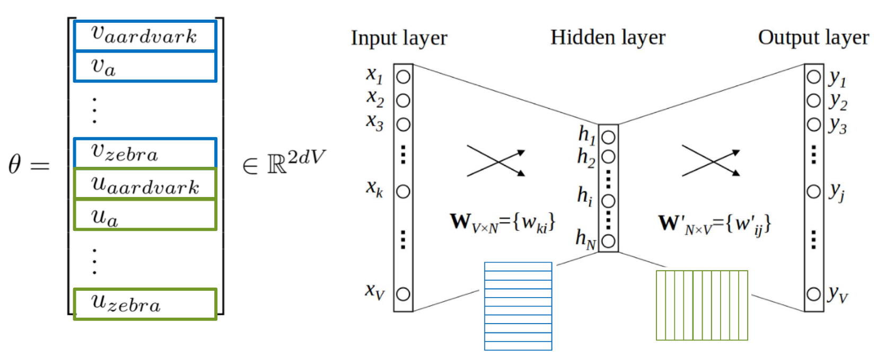

Word2Vec

Slide 25
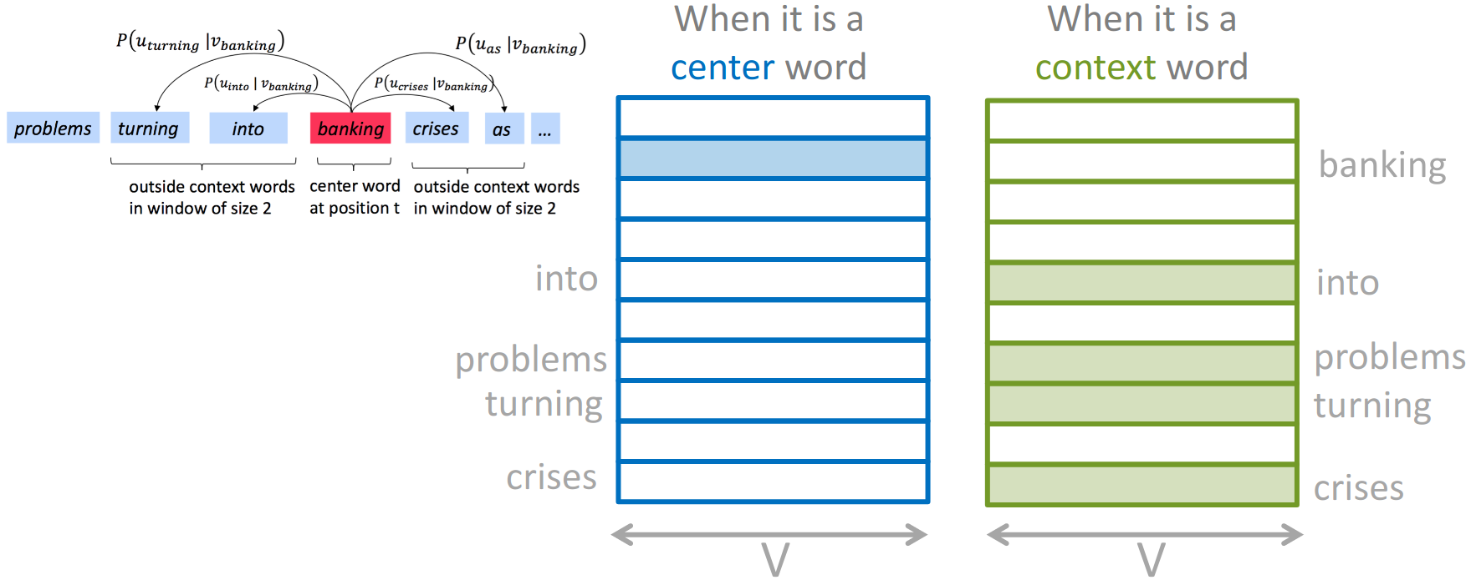
Word2Vec

Slide 26
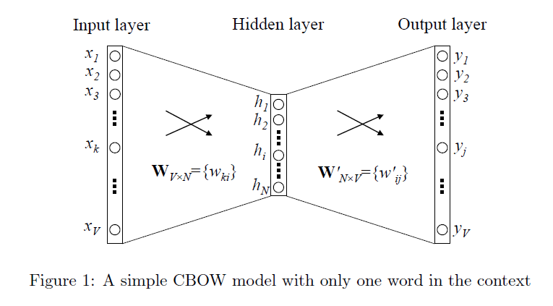

Word2Vec
SoftMax models

Slide 27

Softmax

Slide 28
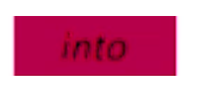
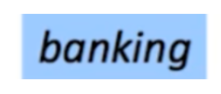
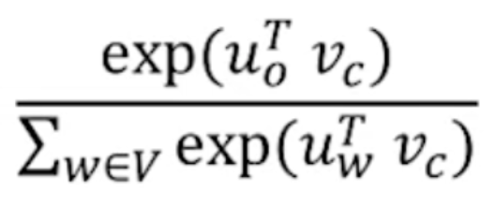
Word2Vec
weight vector v
weight vector u
0
0
0
0.05
0.2
0.5
1
0.02
0
0.1
p(banking | into,v, u) =

Slide 29
Word2Vec
weight vector v
weight vector u
0
0
0
0.05
0.2
0.5
1
0.02
0
0.1
u is a context word vector
v is a center word vector
“Scalar product between me and my neighbour must be as big as possible”
p(banking | into,v, u) =

Slide 30
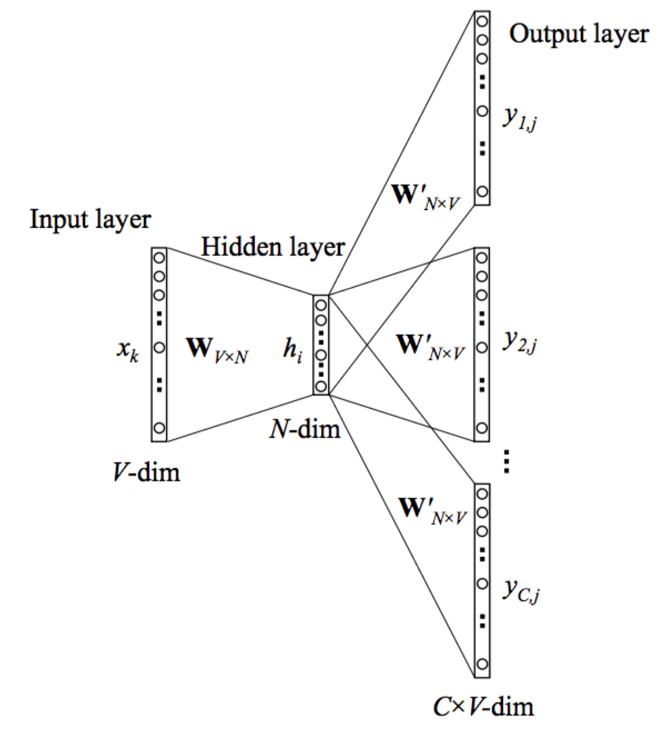
Word2Vec: Skip-Gram
Maximize probabilities of seeing a surrounding word based on center words.

Slide 31
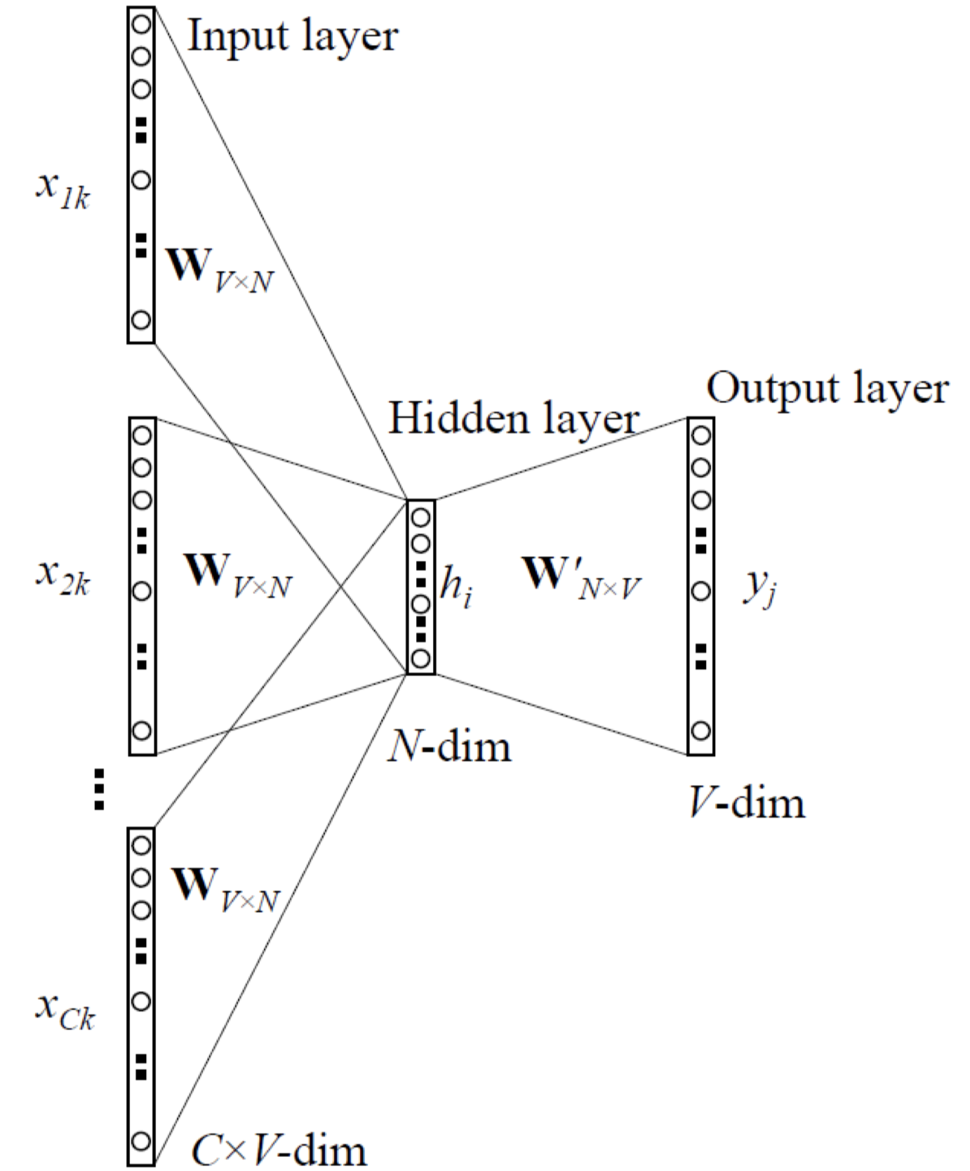




Word2Vec: CBOW
Maximize probabilities of seeing a center word based on surrounding words.

Slide 32
Word2Vec
Skip-gram
CBOW

Slide 33
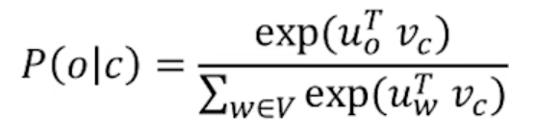
Word2Vec
Problem:
Still big sum to compute

Slide 34
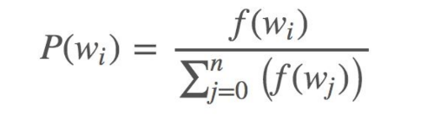
Word2Vec
Problem:
Still big sum to compute
Possible solution:
Negative sampling

Slide 35
Word2Vec vs SVD
Word2Vec with negative sampling ≈ matrix factorization
word vector
word vector
v word
v
SVD
≈
✕
✕
u
u word

Slide 36
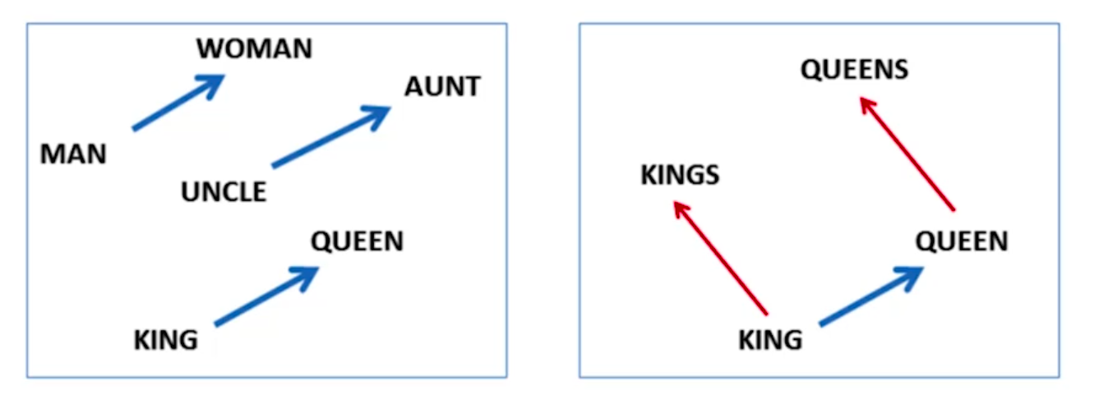
Word2Vec
v(king) - v(man) + v(woman) ≈ v(queen)

Slide 37
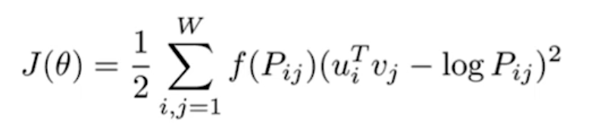
GloVe
Before training count occurrences of pairs [word_{i} , word_{j}] in corpus
Compute probabilities P_{ij} = P ([word_{i}, word_{j}])
Objective function:
Discount factor for rare words

Slide 38
FastText
Divide word into bag of n-grams: apple = <ap, ppl, ple, le>
Compute vector for each n-gram
Vector for a word = sum of vectors for word n-grams

Slide 39
FastText
Divide word into bag of n-grams: apple = <ap, ppl, ple, le> (BPE)
Compute vector for each n-gram
Vector for a word = sum of vectors for word n-grams
Advantages:
Reasonable embeddings for rare words and words with mistakes
Model is the same as before, we can even use model trained on words to train it further on n-grams!

Slide 40
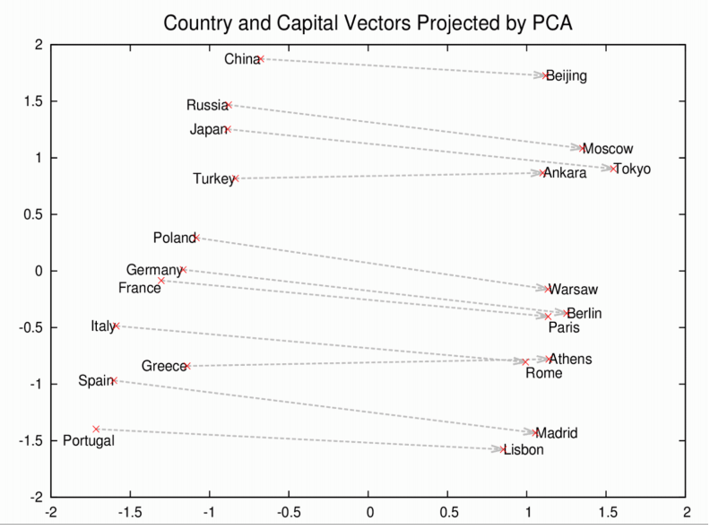

Slide 41
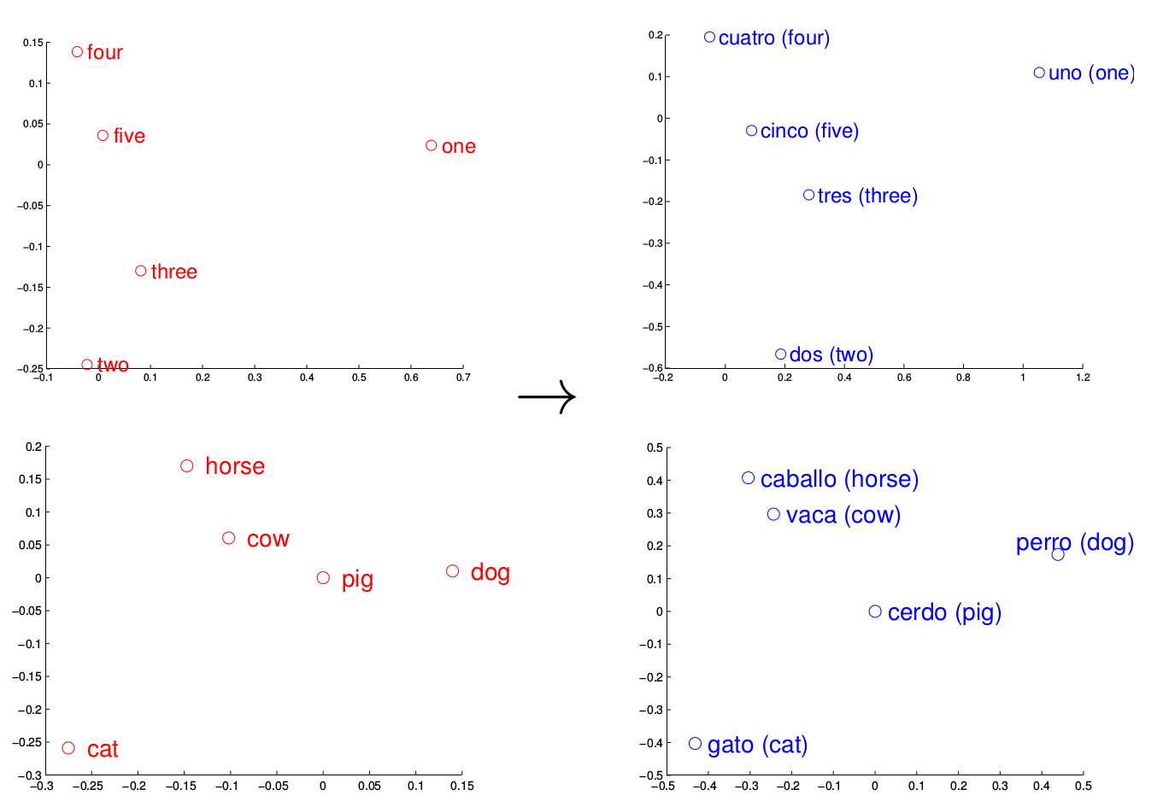
Language similarities
train embeddings for english
find mapping f() from english to spanish
get new english word -- use f() to compute translation!
map
get!

Slide 42
Finally...
Okay, that’s great, but why do we actually need embeddings?

Slide 43
How to solve...
sentiment analysis?
text classification?
… with word embeddings?

Slide 44
Classification task
Output (class, e.g. genre, or emotion)
NN
do something, e.g. average them all or take sentence embedding
embedding layer
I have a cat UNK

Slide 45
Classification task
When you have small text data for your task
Output (class, e.g. genre, or emotion)
NN
pre-trained
do something, e.g. average them all or take sentence embedding
embedding layer
I have a cat UNK

